Slide 1
Requirements Modeling

Slide 2
Requirements Analysis
Requirements analysis
  specifies software’s operational characteristics
  indicates software's interface with other system elements
  establishes constraints that software must meet
Requirements analysis allows the software engineer (called an analyst or modeler in this role) to:
  elaborate on basic requirements established during earlier requirement engineering tasks
  build models that depict user scenarios, functional activities, problem classes and their relationships, system and class behavior, and the flow of data as it is transformed.

Slide 3
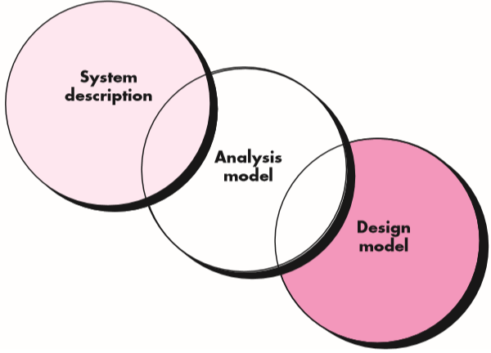
A Bridge

Slide 4
Rules of Thumb
The model should focus on requirements that are visible within the problem or business domain. The level of abstraction should be relatively high.
Each element of the analysis model should add to an overall understanding of software requirements and provide insight into the information domain, function and behavior of the system.
Delay consideration of infrastructure and other non-functional models until design.
Minimize coupling throughout the system.
Be certain that the analysis model provides value to all stakeholders.
Keep the model as simple as it can be.

Slide 5
Domain Analysis
Define the domain to be investigated.
Collect a representative sample of applications in the domain.
Analyze each application in the sample.
Develop an analysis model for the objects.

Slide 6
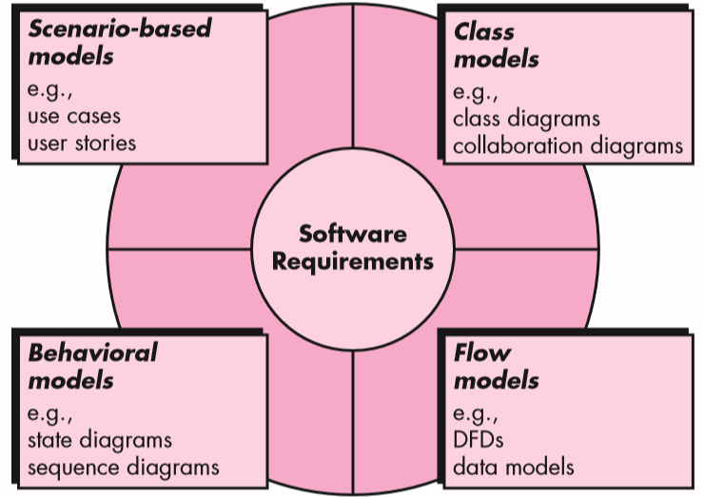
Elements of Analysis Model

Slide 7
Use Cases
What is a Use Case
  A formal way of representing how a business system interacts with its environment
  Illustrates the activities that are performed by the users of the system
  A scenario-based technique in the UML
  A sequence of actions a system performs that yields a valuable result for a particular actor.

Slide 8
Use Case Analysis
What is an Actor?
  A user or outside system that interacts with the system being designed in order to obtain some value from that interaction
Use Cases describe scenarios that describe the interaction between users of the system (the actor) and the system itself.

Slide 9
Use Cases
Use case diagrams describe what a system does from the standpoint of an external observer. The emphasis is on what a system does rather than how.
Use case diagrams are closely connected to scenarios. A scenario is an example of what happens when someone interacts with the system.

Slide 10
Use Cases
Here is a scenario for a medical clinic.
A patient calls the clinic to make an appointment for a yearly checkup. The receptionist finds the nearest empty time slot in the appointment book and schedules the appointment for that time slot. "
We want to write a use case for this scenario.
Remember: A use case is a summary of scenarios for a single task or goal.

Slide 11
Use Cases
Step 1 Identify the actors
As we read the scenario, define those people or systems that are going to interact with the scenario.
A patient calls the clinic to make an appointment for a yearly checkup. The receptionist finds the nearest empty time slot in the appointment book and schedules the appointment for that time slot. "

Slide 12
Questions for Identifying People Actors
Who is interested in the scenario/system?
Where in the organization is the scenario/system be used?
Who will benefit from the use of the scenario/system?
Who will supply the scenario/system with information?
Does one person play several different roles?
Do several people play the same role?

Slide 13
Questions for Identifying Other Actors
What other entity is interested in the scenario/system?
What other entity will supply the scenario/system with information?
Does the system use an external resource?
Does the system interact with a legacy system?

Slide 14
Actors
An Actor is outside or external the system.
It can be a:
  Human
  Peripheral device (hardware)
  External system or subsystem
Represented by stick figure

Slide 15

Use Cases
So as we read our scenario, what or who is the actor????
A patient calls the clinic to make an appointment for a yearly checkup. The receptionist finds the nearest empty time slot in the appointment book and schedules the appointment for that time slot. "
The actor is a Patient.

Slide 16
Use Cases
The use case is a summary of scenarios for a single task or goal.
So What is the Use Case????
The Use Case is Make Appointment.

Slide 17

Use Cases
The picture below is a Make Appointment use case for the medical clinic.
The actor is a Patient. The connection between actor and use case is a association (or communication for short).
Actors are stick figures. Use cases are ovals. Communications are lines that link actors to use cases.
Actors are stick figures. Use cases are ovals. Communications are lines that link actors to use cases.

Slide 18
Use Case Components
The use case has three components.
The use case task referred to as the use case that represents a feature needed in a software system.
The actor(s) who trigger the use case to activate.
The communication line to show how the actors communicate with the use case.

Slide 19
Use Case - Relationships
Relationships
  Represent communication between actor and use case
  Depicted by line or double-headed arrow line
  Also called association relationship
Make
Appointment

Slide 20
Use Case - Relationships
Boundary
  A boundary rectangle is placed around the perimeter of the system to show how the actors communicate with the system.
Make
Appointment

Slide 21
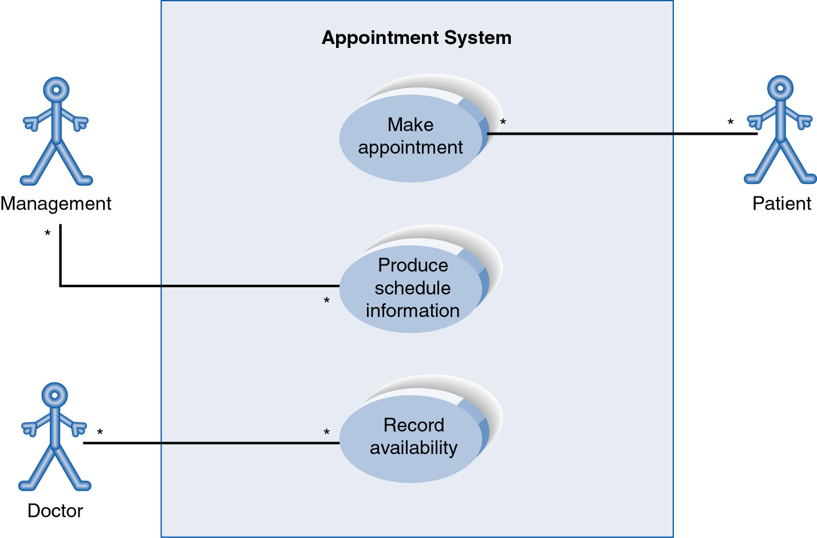
Use-Case Diagram
A use case diagram is a collection of actors, use cases, and their communications.

Slide 22
Use Case Diagram
Other Types of Relationships for Use Cases
  Generalization
  Include
  Extend

Slide 23
Use Case Diagram
Generalization Relationship
  Represented by a line and a hollow arrow
    From child to parent
Child use case
Parent use case

Slide 24
Use Case Diagram
Include Relationship
  Represents the inclusion of the functionality of one use case within another
  Arrow is drawn from the base use case to the used use case
  Write << include >> above arrowhead line

Slide 25
Use Case Diagram
Extend relationship
  Represents the extension of the use case to include optional functionality
  Arrow is drawn from the extension use case to the base use case
  Write << extend >> above arrowhead line

Slide 26
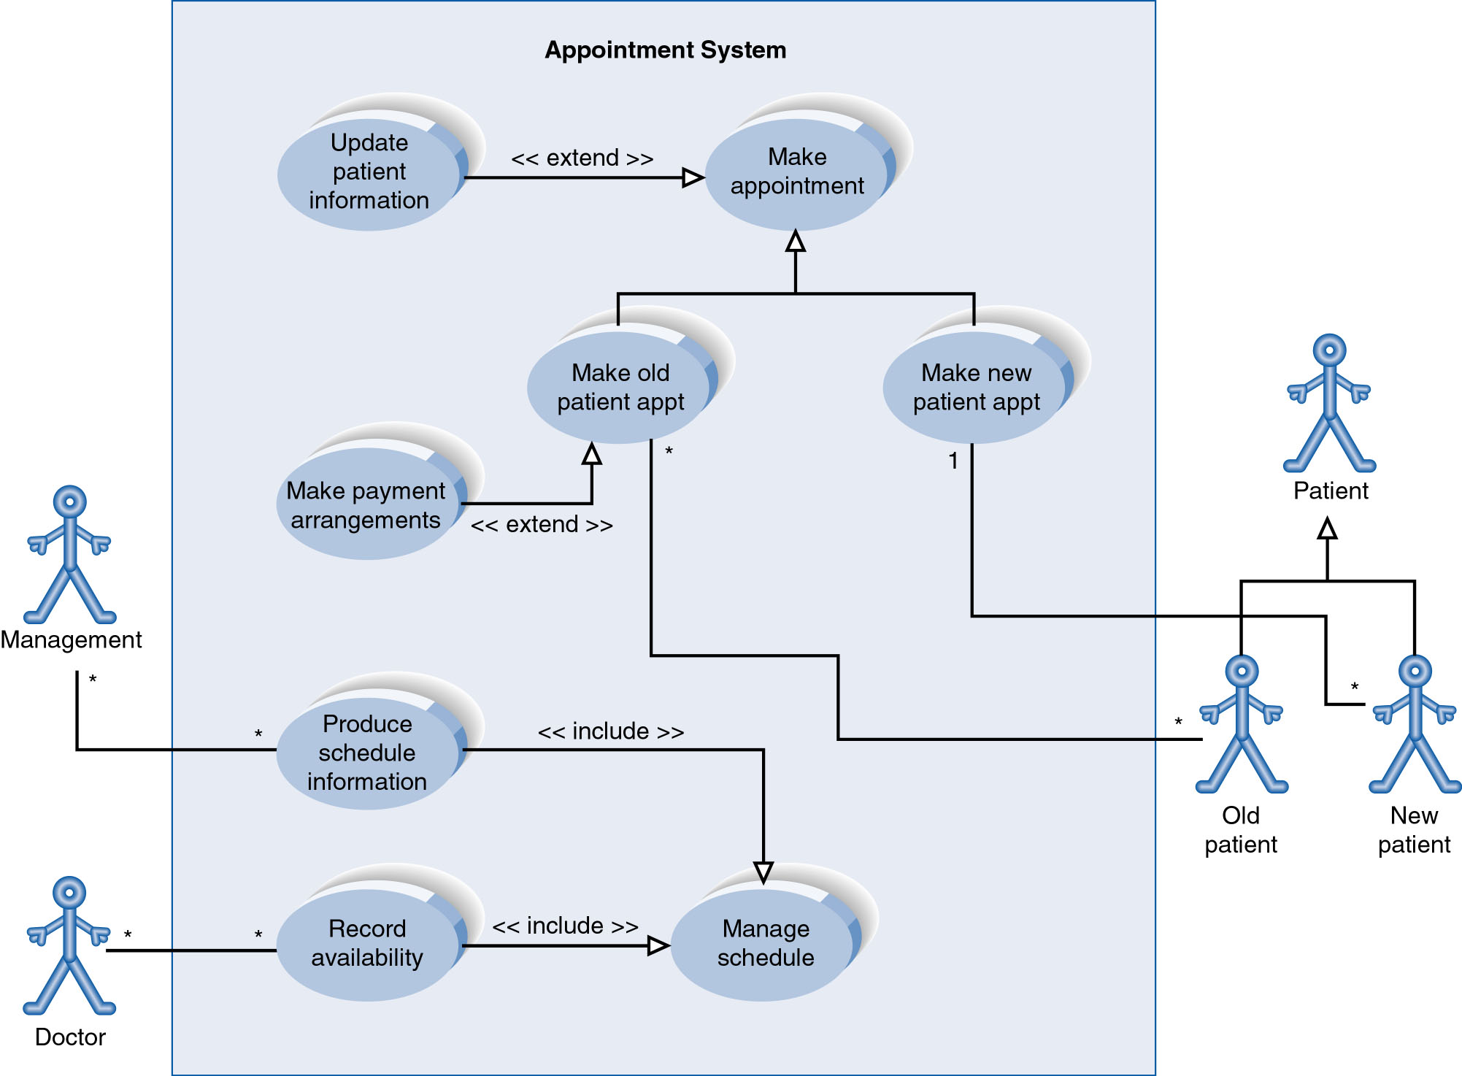
Example of Relationships

Slide 27
Benefits of Use Cases
Use cases are the primary vehicle for requirements capture in RUP
Use cases are described using the language of the customer (language of the domain which is defined in the glossary)
Use cases provide a contractual delivery process (RUP is Use Case Driven)
Use cases provide an easily-understood communication mechanism
Use cases provide a concise summary of what the system should do at an abstract (low modification cost) level.

